Slide 1
Isometric Voxel Tool
A simple 3D isometric voxel based building/painting tool
Suriya Dakshina Murthy
suriya@ucsb.edu
Notes:
Product - i.e. what you made:
Concept and Motivation - i.e why you made it:
Process - i.e. how you made it:
Remaining / Future work:

Slide 2
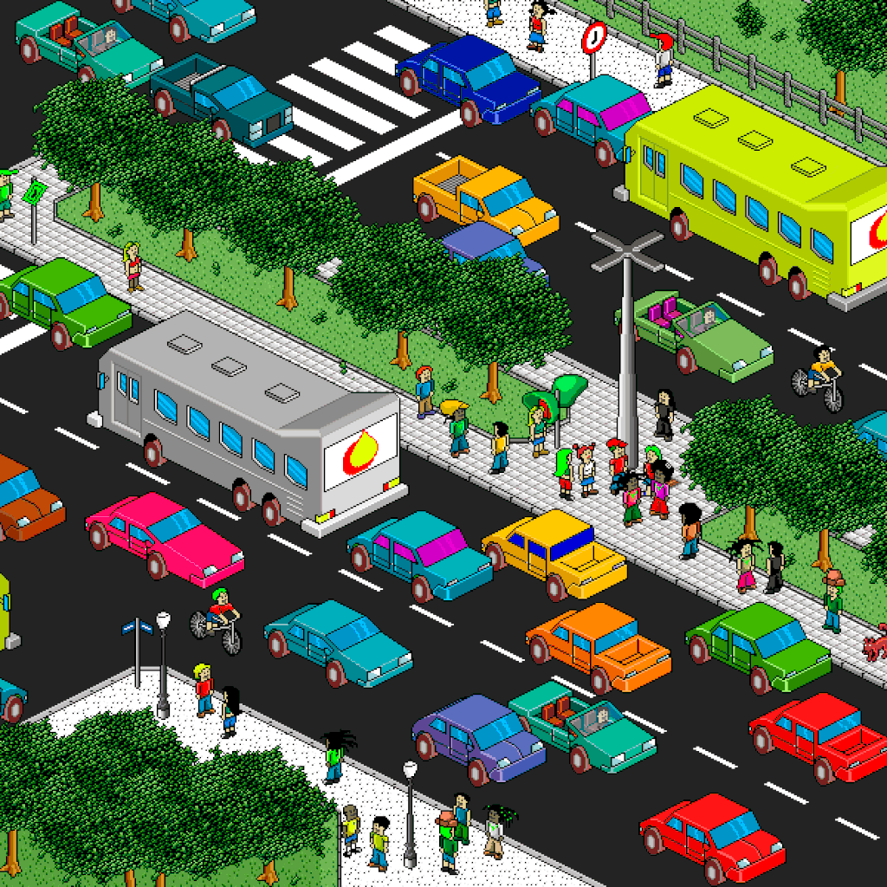
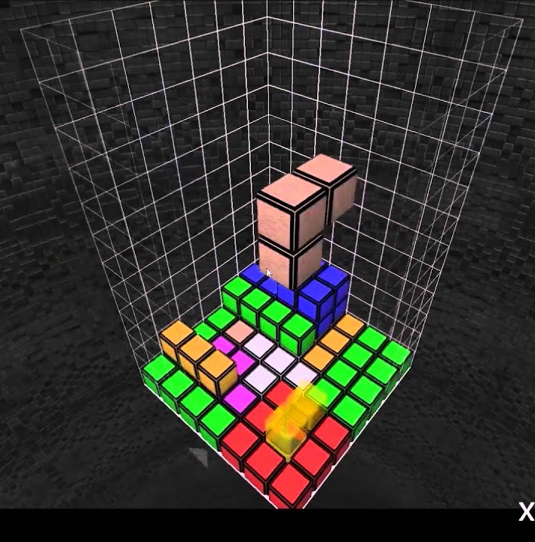
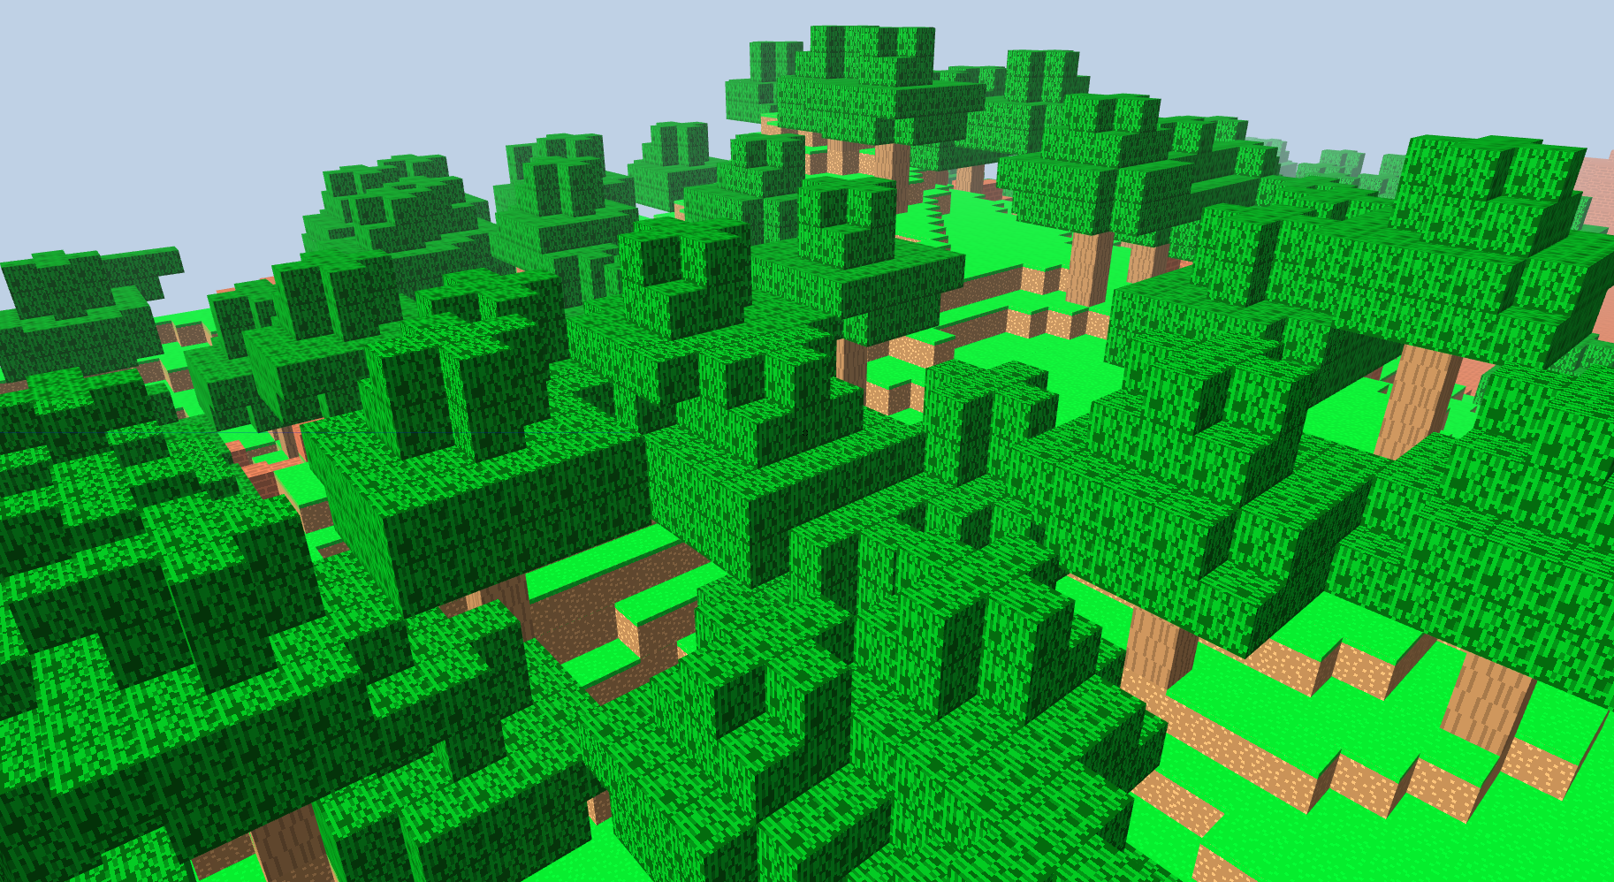
Motivation
Voxel Based Minecraft + Isometric Pixel Art + 3D Tetris

Slide 3
Concept and Motivation
Idea was to build a retro style voxel-based isometric drawing tool - isometry translated the 3D into meaningful 2D and I just needed to find ways to interact with the tool.
Once I decided to build isometric painting tool - I worked on isometric projections to reduce the 3D to 2D and interactions with mouse and keyboard and a simple primitive cube which represented a brush/simple building block.
Notes:
Concept and Motivation - i.e why you made it:

Slide 4
Process
Documented the entire process here.
Motivation to build a free-hand 3D free-hand drawing tool like Google Tilt Brush.
But I soon realized that to build a 3D free-hand drawing tool in 2D requires me to translate meaningful 2D mouse interactions and keyboard interaction to 3D and that was challenging.
So I pivoted the idea to building a retro style voxel-based isometric drawing tool which added two favourable constraints - reducing dimensions and intrun interactions and reducing brush complexity.
I worked on building a Ray Tracer based mouse-cube interaction tool, but translating the camera and coordinate systems took a lot of effort and couldn’t get to work properly - so I pivoted to building a keyboard based interaction.
Notes:
Process - i.e. how you made it:
I learnt that interaction with keyboard is precomputed before the action and for mouse I needed ways to find which state they are going to go next before pressing left mouse button and it is complete wrap around interactivity!

Slide 5
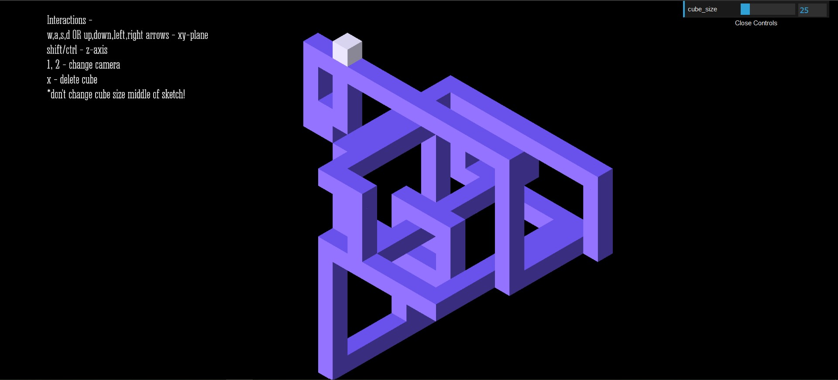
Product
You can give the tool a try here - https://openprocessing.org/sketch/1124370
Screenshot -
Notes:
Product - i.e. what you made:

Slide 6
Future Work
Add options for colors and add more shape primitives.
Allow saving shape informations as new primitives.
Work on the design of the tool - colors and UI.
Work on camera angles.

Slide 7
Thoughts and Feedback

